Slide 1
React Web Applications Masterclass
Creating React Application
SoftUni Team
Technical Trainers
Software University
http://softuni.bg

Slide 2
Table of Contents
create-react-app
Storybook
Testing React Components

Slide 3



Learn to Search in Internet
The course assignments require to search in Internet
This is an important part of the learning process
Some exercises intentionally have no hints
Learn to find solutions!
Software development includes everyday searching and learning
No excuses, just learn to study!
Developers learn new technologies, tools, languages every day!

Slide 4
Link To All Demos

Slide 5
create-react-app

Slide 6
create-react-app
Set up a modern React App by running a single command in seconds
# yarn
yarn global add create-react-app
yarn create react-app swapp
# npm
npm init react-app swapp
# npx
npx create-react-app swapp

Slide 7
create-react-app
Scripts are created for you
"scripts": {
"start": "react-scripts start",
"build": "react-scripts build",
"test": "react-scripts test",
"eject": "react-scripts eject"
}

Slide 8
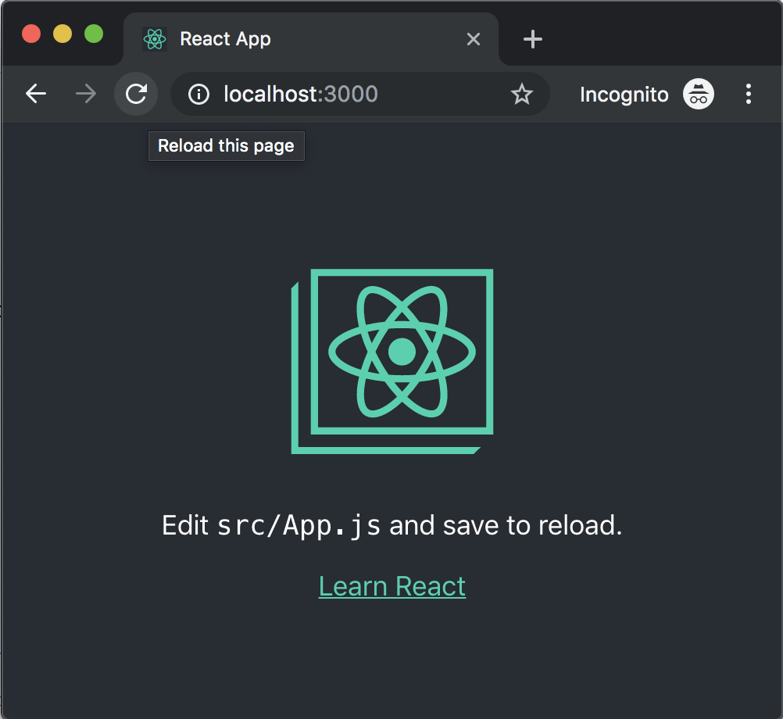
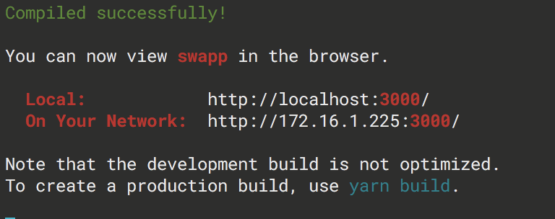
create-react-app
Starting the app
yarn start

Slide 9
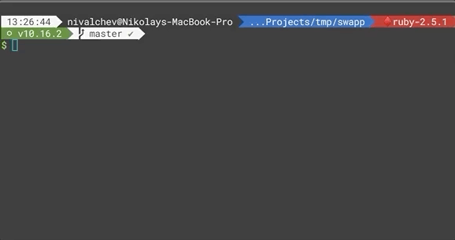
create-react-app
Starting the app
yarn test

Slide 10
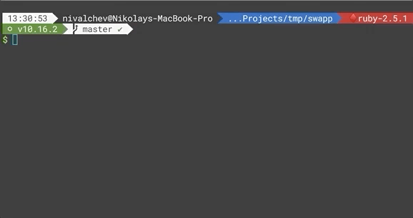
create-react-app
Build the app for production
yarn build

Slide 11
create-react-app
Ejecting your app
Irreversible
Reasons:
Manage the Build
Missing Features
Curiosity
You probably don’t need to!
yarn eject
"scripts": {
"start": "node scripts/start.js",
"build": "node scripts/build.js",
"test": "node scripts/test.js"
}

Slide 12
create-react-app
Folder Structure
index.html and index.js are musts
src is picked by Webpack
index.html only refers /public
cra-demo
├── README.md
├── node_modules
├── package.json
├── public
│ ├── favicon.ico
│ ├── index.html
│ ├── logo192.png
│ ├── logo512.png
│ ├── manifest.json
│ └── robots.txt
├── src
│ ├── App.css
│ ├── App.js
│ ├── App.test.js
│ ├── index.css
│ ├── index.js
│ ├── logo.svg
│ └── serviceWorker.js
└── yarn.lock

Slide 13
create-react-app
Supported Browsers and Features¹
ES6+ Syntax
browserslist² controls output
no polyfills
"browserslist": {
"production": [
">0.2%",
"not dead",
"not op_mini all"
],
"development": [
"last 1 chrome version",
"last 1 firefox version",
"last 1 safari version"
]
}

Slide 14
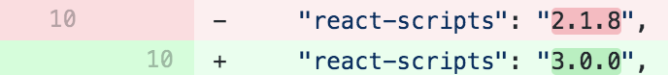
create-react-app
Easy to maintain/update*
yarn upgrade react-script --latest

Slide 15
Keynotes

Slide 16
Keynotes
Webpack
Eslint
Styles and Assets
Environment Variables
Progressive Web Apps
Jest

Slide 17
Webpack¹
Open-Source JavaScript Bundler
Builds Dependency Module Graph
Picks up non-JS files via Loaders
Bundle Optimizations via Plugins
Code Splitting

Slide 18
Eslint
A pluggable and configurable linter tool for identifying and reporting on patterns in JavaScript.
Maintain code consistency
Enforces Good Practices
Simplifies PR Reviews
eslint-plugin-react

Slide 19
Styling and Assets
Webpack extends the concept of import
Importing images, fonts, svgs. etc
Importing Styles

Slide 20
CSS/SASS Styling
Import CSS or SASS* files as dependency
Import CSS or SASS* modules
[name].module.{css,scss}
Style scoping via unique classnames

Slide 21
Environment Variables
via Shell or .env
Reserved Environment Variables (e.g. PORT)
Custom Environment Variables
Used for custom purposes (e.g. setting the backend server url)
Must be prefixed with REACT_APP_ (e.g. REACT_APP_BE_URL)

Slide 22
Progressive Web App
Web Apps having specific set of characters:
Progressive
Responsive
Connectivity independent
App-like
Faster after initial loading
Progressive by Default*
Service Worker

Slide 23
Best Practices

Slide 24
Best Practices
Pin the Node.js version
Opinionated Formatter
Pre-commit hooks
CI/CD

Slide 25
Pin the Node.js version
Limits Hard to Reproduce Issues
Ensures Node.js version consistency
nvm, nvm-windows, nodist

Slide 26
Node Version Manager (nvm)
Install nvm
echo [desired version] >> .nvmrc
nvm use
or set up automatic nvm use call

Slide 27
Opinionated Code Formatting
Prettier
Resolves visual esthetics arguments
Uses cosmiconfig
Create format script
"scripts": {
...
"format": "prettier --write \"src/**/*.{js,json}\""
}

Slide 28
Pre-Commit Hooks
Execute linters on files that are going to be committed.
Husky
lint-staged
"husky": {
"hooks": {
"pre-commit":
"cross-env CI=true lint-staged"
}
}
"lint-staged": {
"src/**/*.js": [
"prettier --write",
"eslint --max-warnings=0",
"yarn test --bail --findRelatedTests",
"git add"
]
}

Slide 29
Continuous Integration/Deployment
Always use Pull/Merge Requests
Run CI Build on each PR
Deploy Automatically the master branch

Slide 30
Storybook

Slide 31
Storybook
Storybook is an open source tool for developing UI components in isolation

Slide 32
Storybook
Build Components in Isolation
Mock Hard to Reach Use Cases
Document Use Cases as Stories
Enhance with Addons

Slide 33
How to add Storybook?
# Init Storybook
npx -p @storybook/cli sb init
# Start Storybook
yarn storybook
# Start Storybook
yarn build-storybook
"scripts": {
...
"storybook": "start-storybook -p 9009 -s public",
"build-storybook": "build-storybook -s public
}

Slide 34
Storybook
Loading Stories - .storybook/config.js
Adding Decorators
Addons

Slide 35
Testing React Components

Slide 36
But Why?
Capture Regressions
Ensure Proper Visual Content
Validate UX
Documentation
Encourages High Quality Code

Slide 37
Jest

Slide 38
What is Jest?
Jest is a delightful JavaScript Testing Framework with a focus on simplicity.*

Slide 39
Features
Fast and Safe
Code Coverage
Mocking API
GOOD Exceptions
Great Documentation

Slide 40
Configuration
Little to None
Options Config
package.json or jest.config.js
Filename Conventions
.js files in __tests__ folders
.test.js files
.spec.js files
Global Setup File:
src/setupTests.js
"jest": {
"snapshotSerializers": [
"enzyme-to-json/serializer"
],
"collectCoverageFrom": [
"src/**/*.{js,jsx}",
],
"coverageThreshold": {
"global": {
"branches": 100,
"functions": 100,
"lines": 100,
"statements": 100
}
}
}

Slide 41
Basic API
describe
test/it
beforeAll/afterAll
beforeEach/afterEach
expect(actual).<matcher>(expected)
grouping/scoping tests
test case definition
one-time scoped setup
repeating setup
test assertion (matchers)

Slide 42
Unit Tests
DEMO

Slide 43
Rendering Tools

Slide 44
Test in Components?
Smoke Tests
Input - Output
Behavior

Slide 45
How we test Components?
enzyme
React Testing Libraries

Slide 46
Enzyme

Slide 47
Rendering Methods
Shallow Rendering
Mount (Full) Rendering

Slide 48
Shallow Render
Shallow rendering is useful to constrain yourself to testing a component as a unit, and to ensure that your tests aren't indirectly asserting on behavior of child components.¹

Slide 49
Shallow Render
Testing components in isolation
Container components
Documenting Behavior
Unit Testing

Slide 50
Shallow Render
Using shallow API
creates ShallowWrapper
componentDidMount and componentDidUpdate

Slide 51
Mount Render
Full DOM rendering is ideal for use cases where you have components that may interact with DOM APIs or need to test components that are wrapped in higher order components.¹

Slide 52
Mount Render
Testing components integration
Presentational Components
Testing DOM elements interactions
Browser-Like Environment
Integration Testing

Slide 53
Mount Render
Using mount API
creates ReactWrapper
mounts the component in the DOM

Slide 54
Enzyme Drawbacks
Allows testing implementation details
Relying on non-public interface
Depending Components’ Names
Asserting Component State
Invoking Function Props

Slide 55
React Testing Library

Slide 56
React Testing Library
Guiding principle:
We try to only expose methods and utilities that encourage you to write tests that closely resemble how your web pages are used.¹

Slide 57
React Testing Library
Builds on top of DOM Testing Library¹
Light-weight
Works with actual DOM nodes

Slide 58
Mocking

Slide 59
Moc… What?
Mock is an imitation, usually of lesser quality.¹

Slide 60
Mocked Objects
Mock objects are simulated objects that mimic the behavior of real objects in controlled ways, most often as part of a software testing initiative.¹

Slide 61
Why do we mock?
Isolate dependencies outside of our control
Ensure we have passing tests

Slide 62
What do you want to mock?
Network (API) calls
Date-related stuff
Environment (e.g. env vars)
Behaviors/Objects that aren’t target of the current test
Timers

Slide 63
Mocking API
jest.fn([implementation])¹ - creates unused mocked function
jest.spyOn(object, methodName)² - wraps object[methodName] in mock function and returns the later
mockFn.methods³

Slide 64
Mocking Timers¹
jest.useFakeTimers() - Instructs Jest to use fake versions of the standard timer functions
jest.runAllTimers() - Exhausts both the macro-task queue and the micro-task queue
jest.advanceTimersByTime(ms) - Executes only queued task in the macro task queue
jest.runOnlyPendingTimers() - Executes only the macro-tasks that are currently pending

Slide 65
Best Practices

Slide 66
Best Practices
Start with snapshot tests
Inputs + Simulated Events = Output
Use helper functions
Place tests as close as possible to the implementation
Changing implementation details (refactoring) should rarely cause a test to fail.

Slide 67


Slide 69
List of My Extensions
code --install-extension andys8.jest-snippets
code --install-extension antmdvs.vscode-react-hooks-snippets
code --install-extension azemoh.one-monokai
code --install-extension bungcip.better-toml
code --install-extension christian-kohler.npm-intellisense
code --install-extension christian-kohler.path-intellisense
code --install-extension dbaeumer.vscode-eslint
code --install-extension DotJoshJohnson.xml
code --install-extension dsznajder.es7-react-js-snippets
code --install-extension eamodio.gitlens
code --install-extension EditorConfig.EditorConfig
code --install-extension eg2.vscode-npm-script
code --install-extension EQuimper.react-native-react-redux
code --install-extension esbenp.prettier-vscode
code --install-extension formulahendry.code-runner
code --install-extension jasonnutter.search-node-modules
code --install-extension jeremyrajan.webpack
code --install-extension kumar-harsh.graphql-for-vscode
code --install-extension mgmcdermott.vscode-language-babel
code --install-extension msjsdiag.debugger-for-chrome
code --install-extension msjsdiag.vscode-react-native
code --install-extension Orta.vscode-jest
code --install-extension redhat.vscode-yaml
code --install-extension streetsidesoftware.code-spell-checker
code --install-extension timothymclane.react-redux-es6-snippets
code --install-extension uloco.theme-bluloco-light
code --install-extension vscode-icons-team.vscode-icons
code --install-extension waderyan.babelrc
code --install-extension xabikos.JavaScriptSnippets
code --install-extension xabikos.ReactSnippets
code --install-extension yzhang.markdown-all-in-one

Slide 70






СофтУни диамантени партньори

Slide 71






СофтУни диамантени партньори

Slide 72





Trainings @ Software University (SoftUni)
Software University – High-Quality Education, Profession and Job for Software Developers
softuni.bg
Software University Foundation
http://softuni.foundation/
Software University @ Facebook
facebook.com/SoftwareUniversity
Software University Forums
forum.softuni.bg

